Slide 1
Besties Gadget Marketing.com

Slide 2
TODAYS Presenters
Order of Presentation:
Home Page & Add to Cart (by Samiullah 21f-9200)
Laptop (BY Samiullah 21f-9200)
Watch & Feedback(BY Adnan Ali 21f-9220)
Mobile & Thank you Page (BY Adnan Ali 21f-9220)

Slide 3
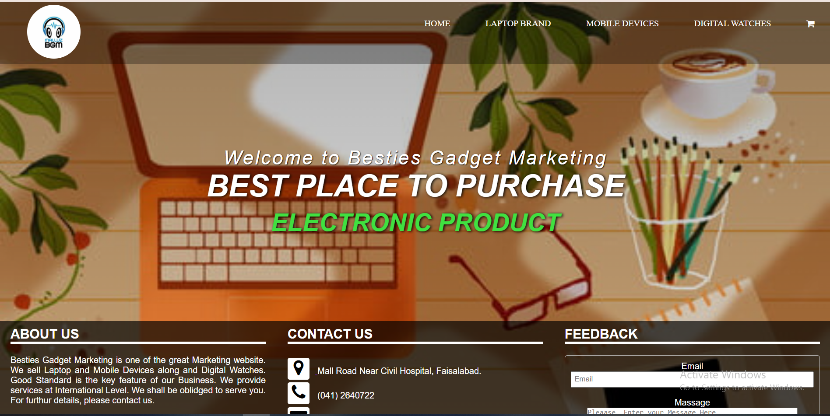
Home Page
Title.
Sub-title.

Slide 4
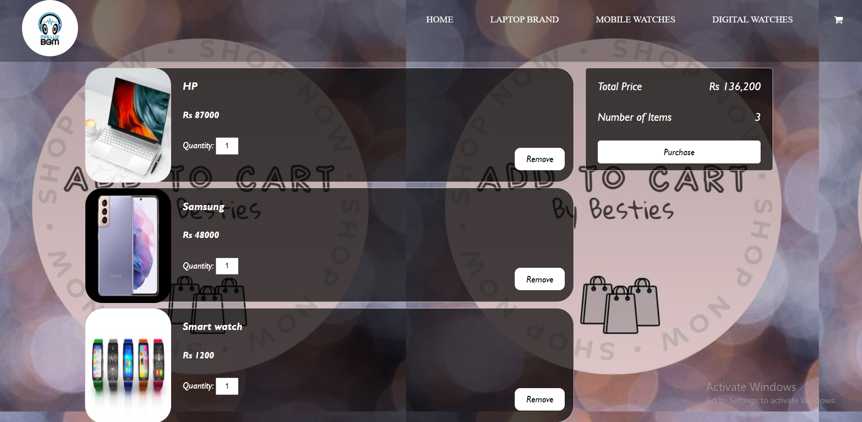
Add to Cart
Tabs of Products.
Total Cost Tab.
Button.

Slide 5
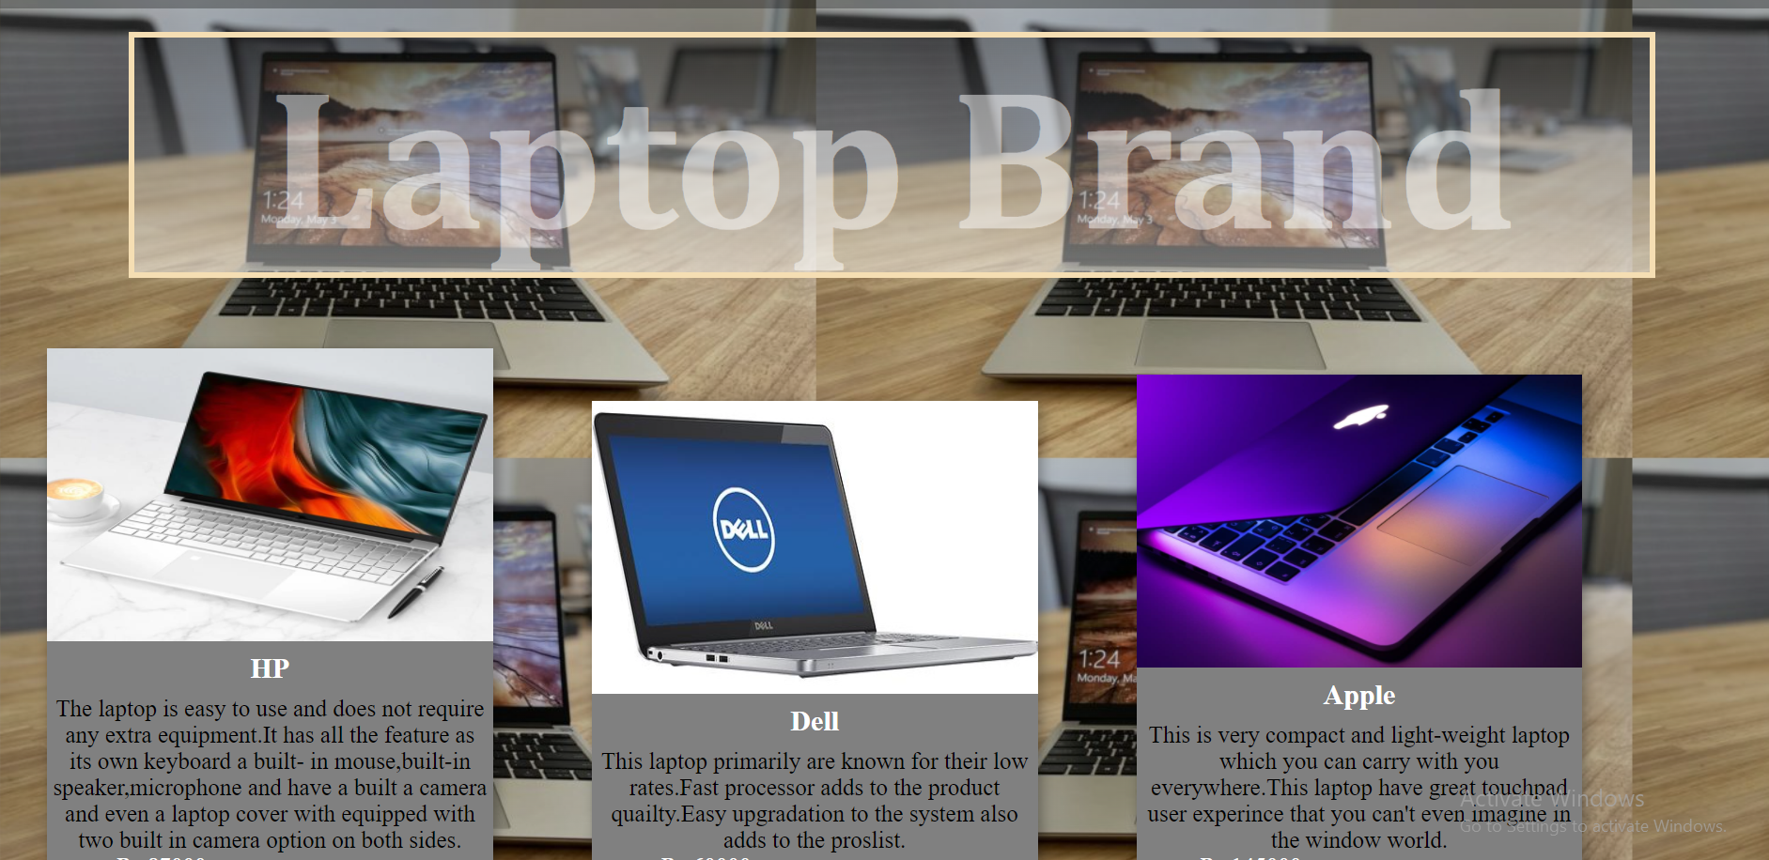
Laptop Brand
Heading.
Cards.

Slide 6
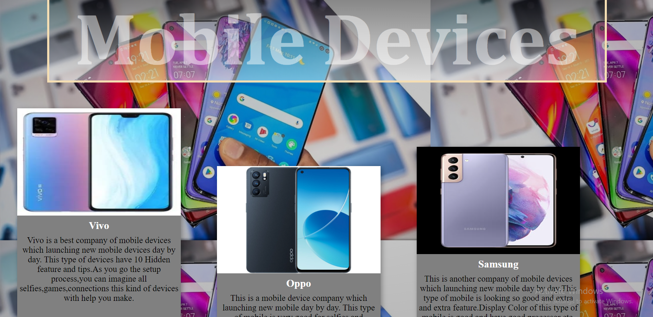
Digital Watches
Image Customization.
Description Design.

Slide 7
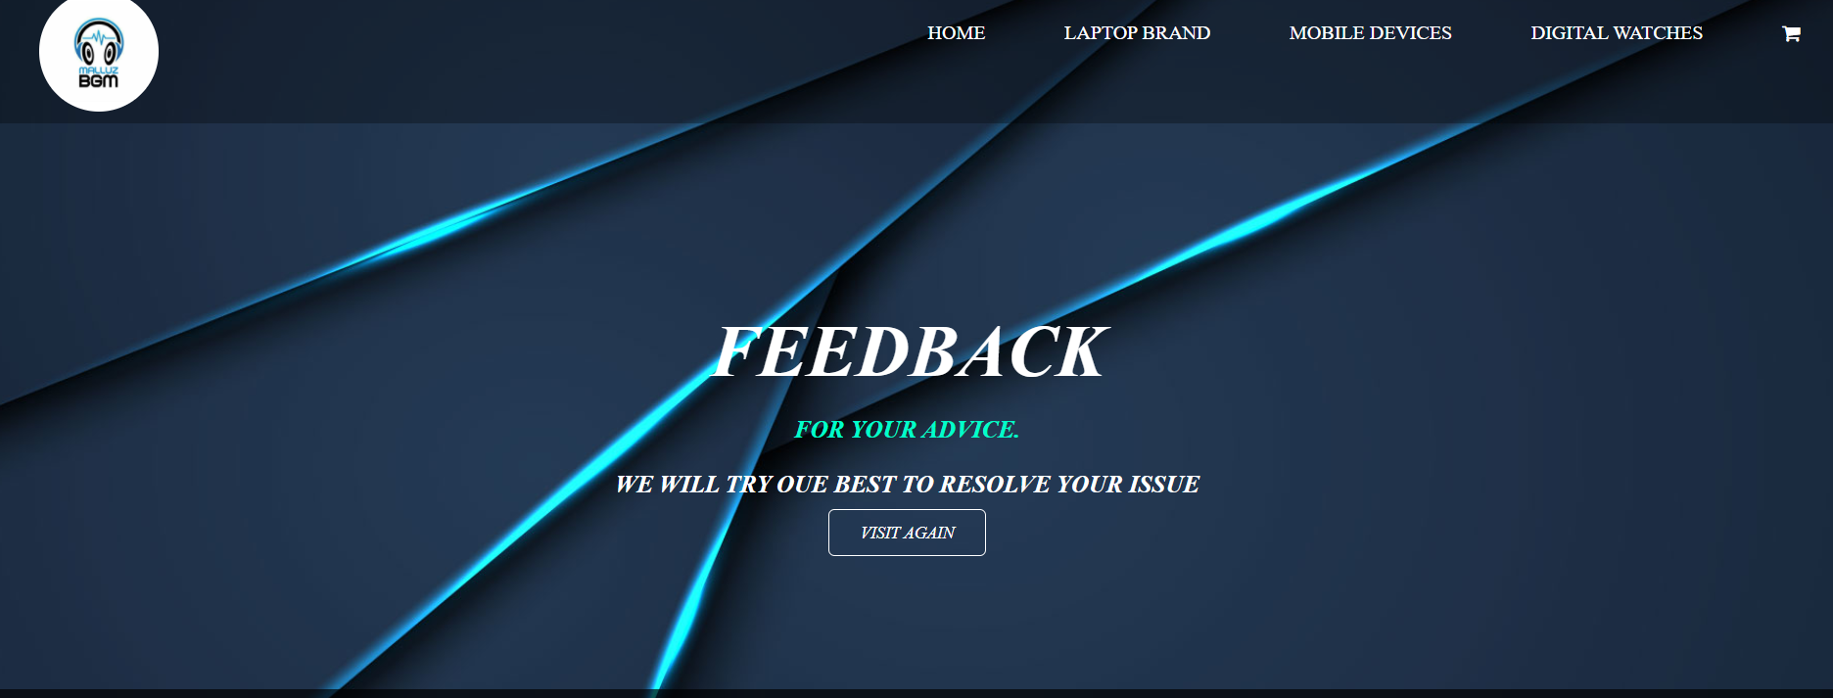
Feedback Message
Colors.
Customizes Text.
Button.

Slide 8
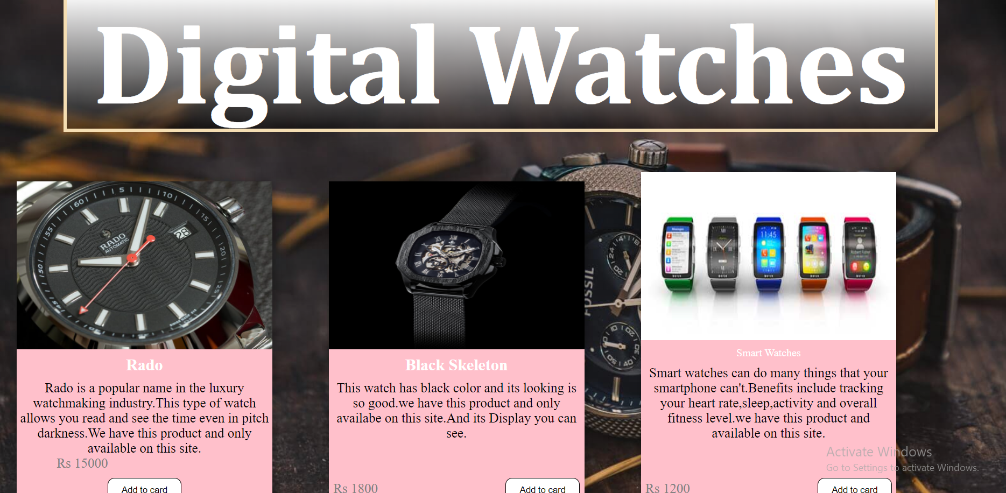
Mobile Devices:
Add to Cart Button.
Customization of Button

Slide 9






Thank You Page

Slide 10
THANK YOU!
FOR YOUR TIME!

